Slide 1

Smart Cycle Docking Station
Under the Guidance of
Prof. Dr. Achim Gottscheber
Presented By:
Sriram Hulugundi Venkatesha

Slide 2
Contents
RFID
UHF RFID
Need for smart docking station
Architecture of the overall system
Overview of Docking station
Advantages of using RFID
Future scope

Slide 3
RFID
Radio Frequency Identification
Uses electromagnetic fields
Automatically identify and track tags attached to objects

Slide 4
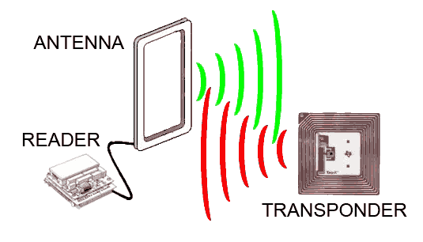
Source: http://www.animalmigration.org/RFID/index.htm

Slide 5
UHF RFID
Used radio-frequency in the range 865-868 MHz in Europe region
Works with both passive and active tags

Slide 6
Need for Smart docking station
Helps in locating cycles easily in a large campus
Employees in Roche campus Mannheim faces similar kind of issue
Helps in reducing accumulation of cycles in one place of the campus

Slide 7
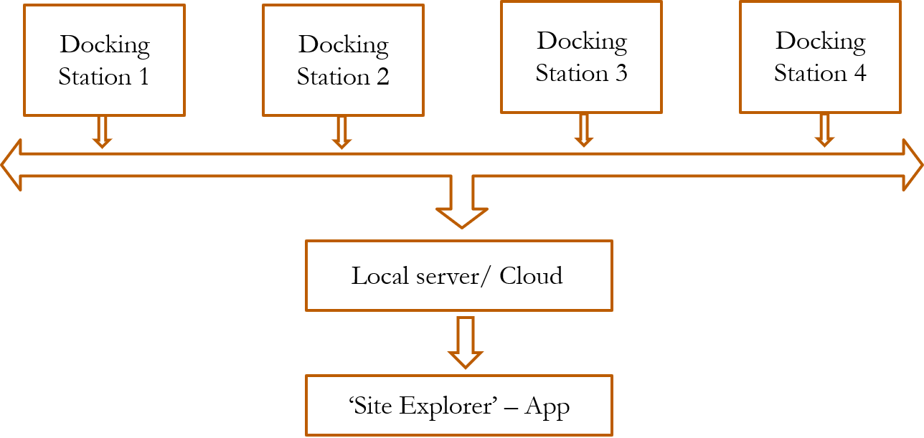
Architecture of the docking station

Slide 8
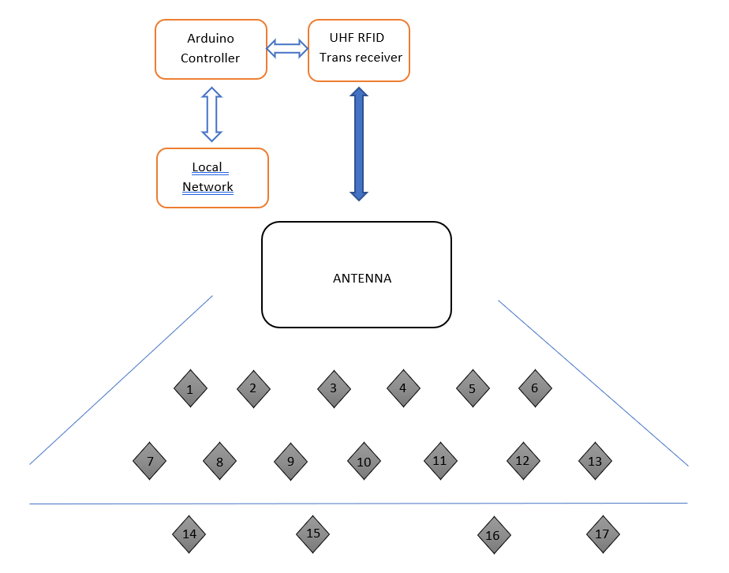
Overview of Docking Station

Slide 9
Advantages of using RFID
Tags are passive
Passive tags are maintenance free
The setup is highly scalable
The system is adaptable to many other systems

Slide 10
Future scope
The project is not limited to only cycle stations, but also can be used for other purposes like:
Vehicle parking systems
Asset tracking in warehouses
Smart billing systems in supermarkets

